Slide 1
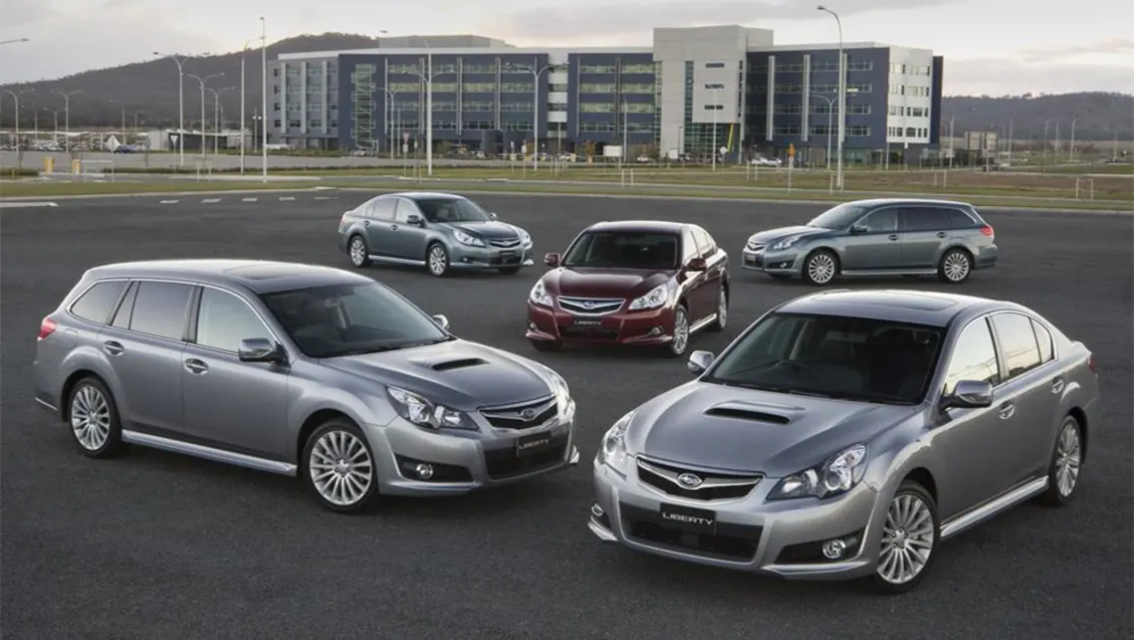

CAR PRICE PREDICTION
Presented by:
Mark Stephen
Halley Pham
Yan Shao
Carl Gonzales

Slide 2
Why do we want to predict the price of cars?
Can be a major research area in machine learning.
The used car market has demonstrated a significant growth in value over the years.
The price of a car depends on multiple factors such as: year, kilometres driven, fuel, engine type, transmission, no. of owners etc.

Slide 3
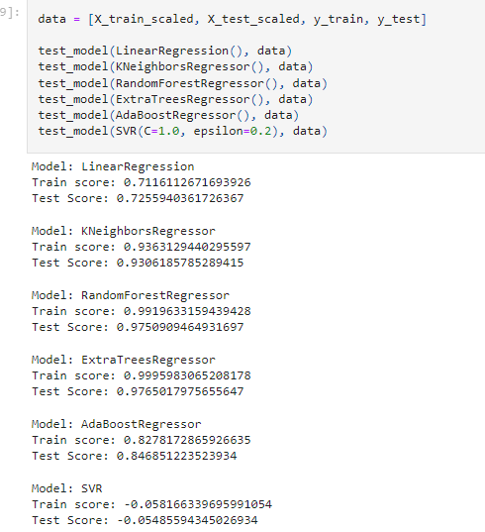
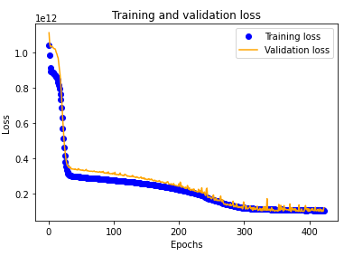
Project Overview
The aim is to find the most accurate method of predicting the value of pre-owned vehicles from an online dataset.
Cleaning and visualizing our data
Using a pre-trained model from the SK library.
Building and training our own NN model.

Slide 4
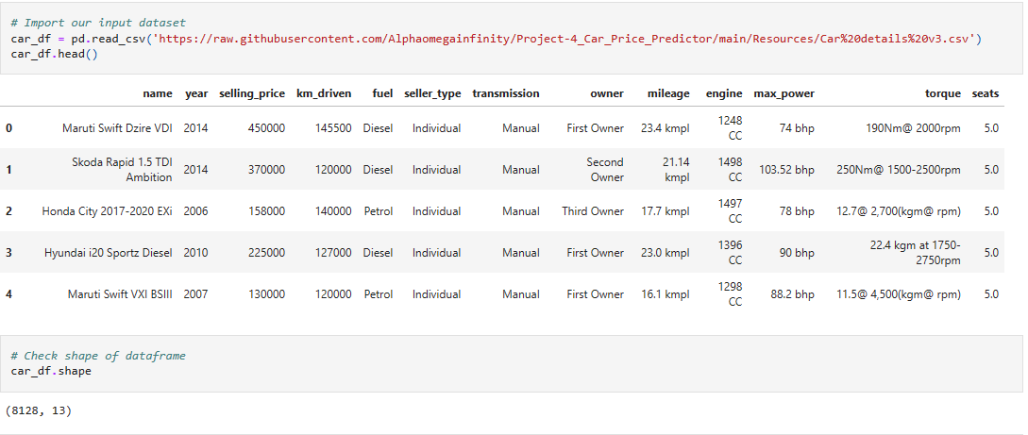
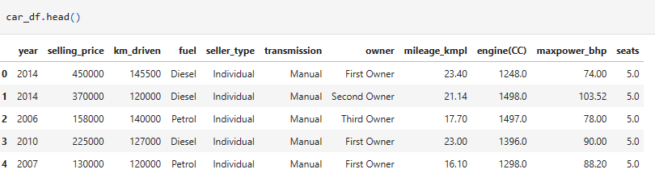
Light cleaning
Import, Read and do light cleaning

Slide 5
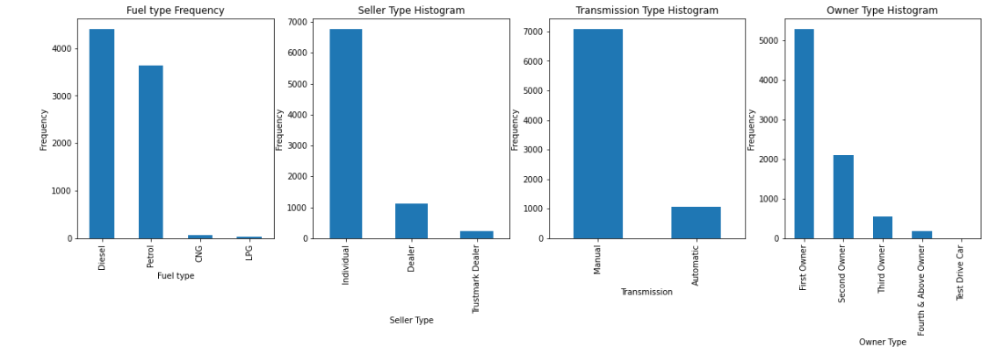
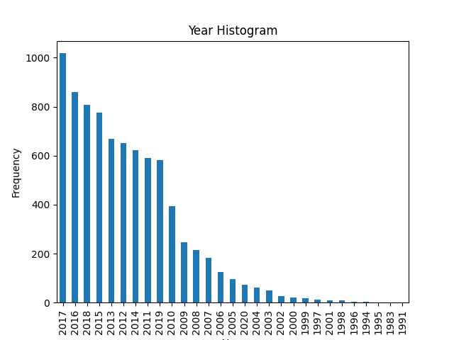
Data Cleaning Process - Visualization Categorical Data
Checking any outliers

Slide 6
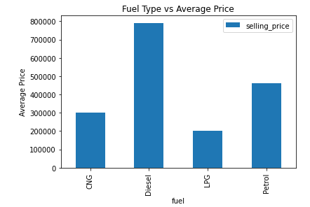
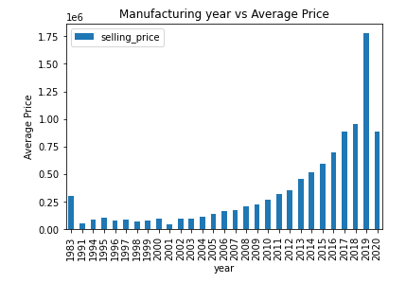
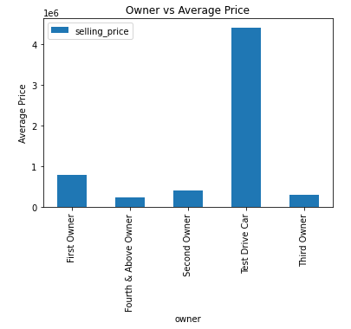
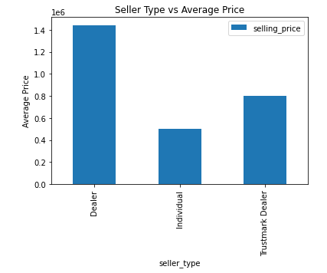
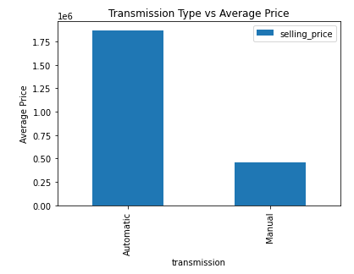
Data Cleaning Process-
Categorical Variable vs Aver.price
Checking all the categorical data vs Average Price to find out any significant/outlier values:
Manufacturing year has outliers
1e6 = 10 to the power of 6

Slide 7
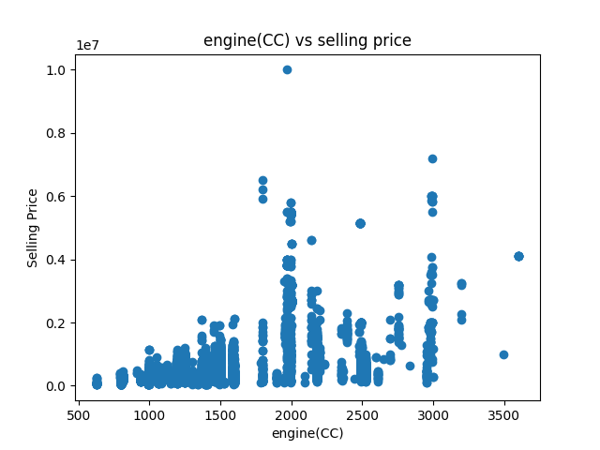
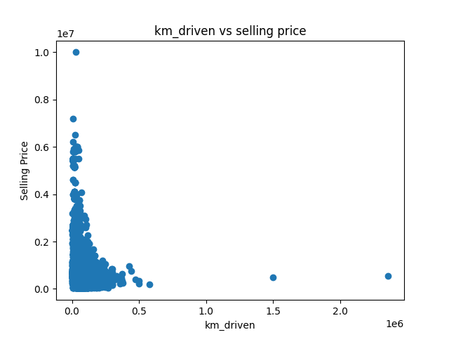
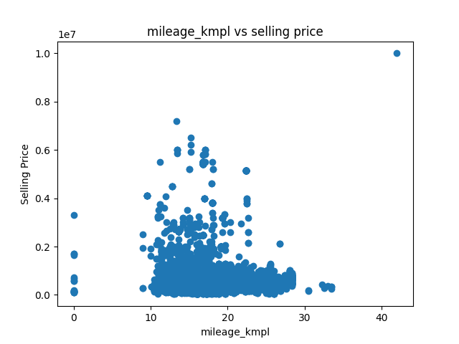
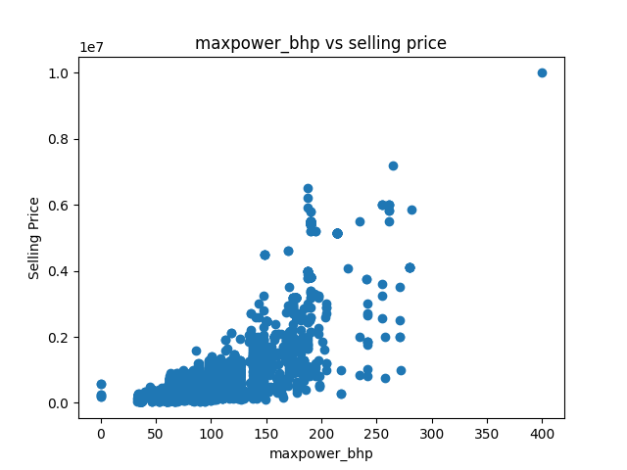
Data Cleaning Process-
Numerical Variable vs Selling price

Slide 8
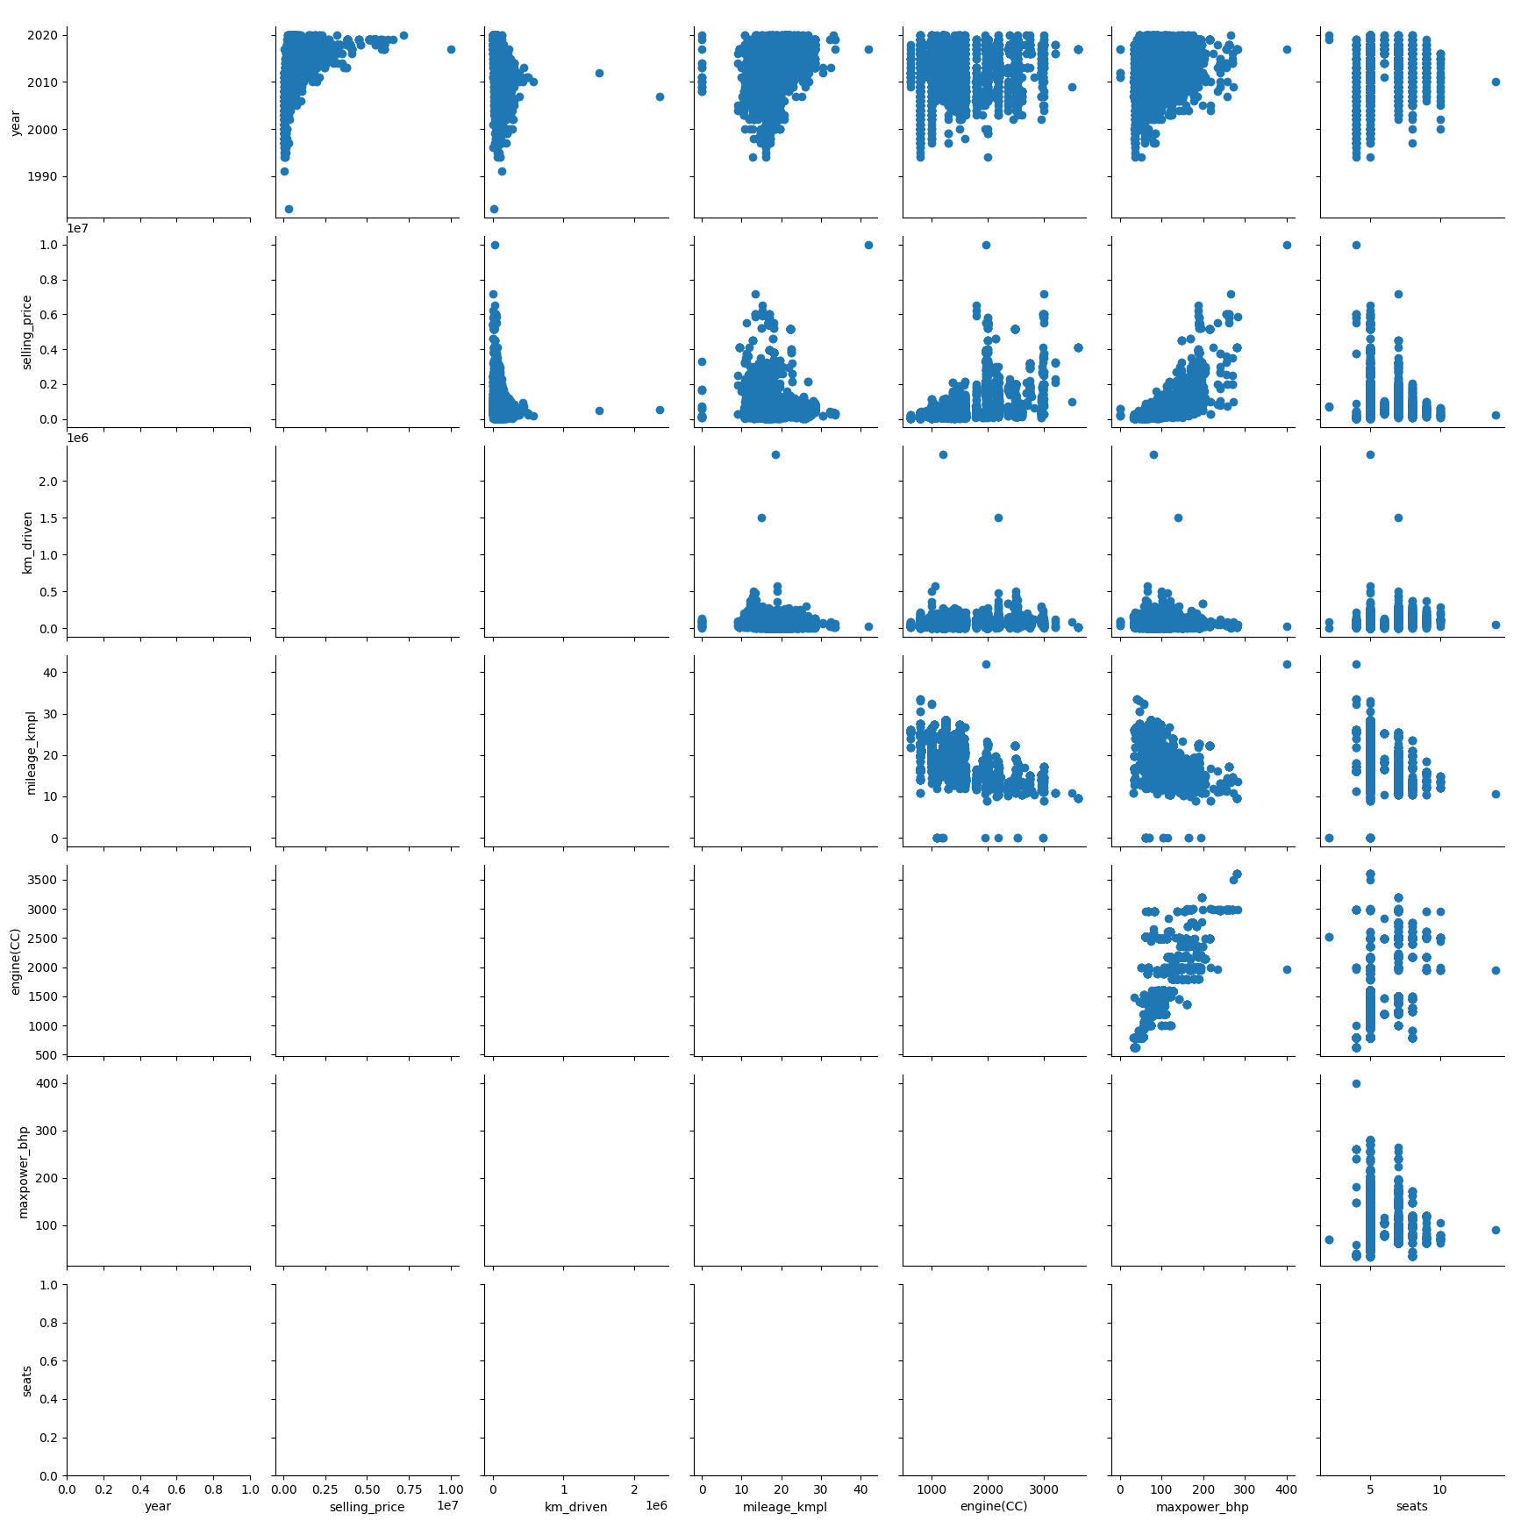
Correlation Matrix Visualization
max power variable has the most correlation with other variables

Slide 9
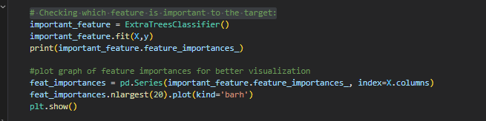
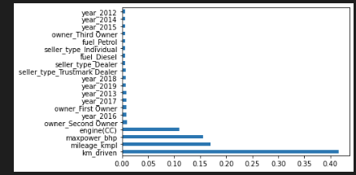
Feature Importances Visualization
After all the data visualisations, we split our preprocessed data into our features and target arrays.
We are checking which features are important to the target using Extra Trees Classifier function.
The feature importances bar chart displayed on the left, we could see the most important feature is km-driven.

Slide 10

Select the best fit model
After splitting our data into Training and Testing data, we want to see which regressor model would perform the best.
Model Tested:
Linear ,
Kneighbor,
RandomForest
ExtraTrees
AdaBoost
SVR
It is shown that ExtraTrees Regression performs the best with Training score of 99.96% and testing score of 97.65%
Aaf

Slide 11
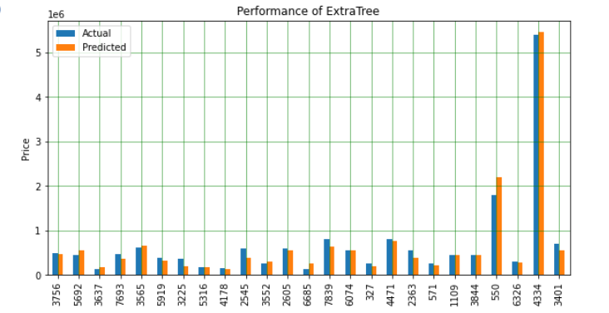
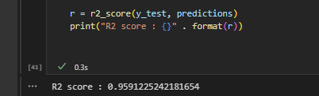
Model Demonstration— Extra Tree Regression
& RandomizedSearchCV
After getting the best model with the highest training score and testing score, we then imported RandomizedSearchCV to perform hyper parameter tuning.
The graph above showed the actual price and the predicted price and our R2 score is 0.9591.

Slide 12
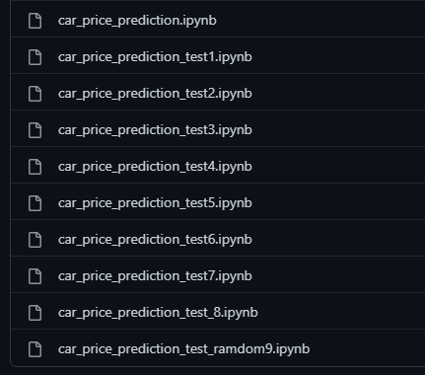
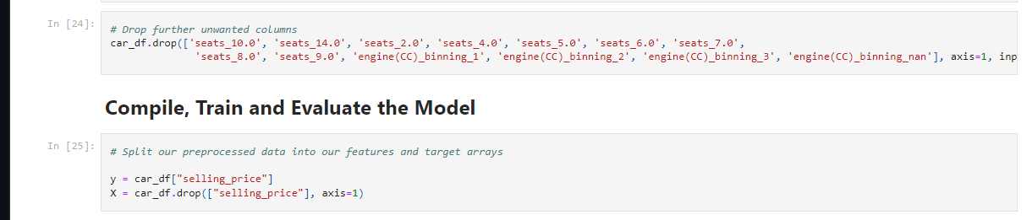
Making our own Deep Learning Model
After finding that a pre trained regression model performed the best with our data we then attempted to make our own deep learning regression model to obtain the same results. We then started to adjust the data to feed into our deep learning model to see which combinations of data gave us the most accurate line between our training and testing datasets.

Slide 13
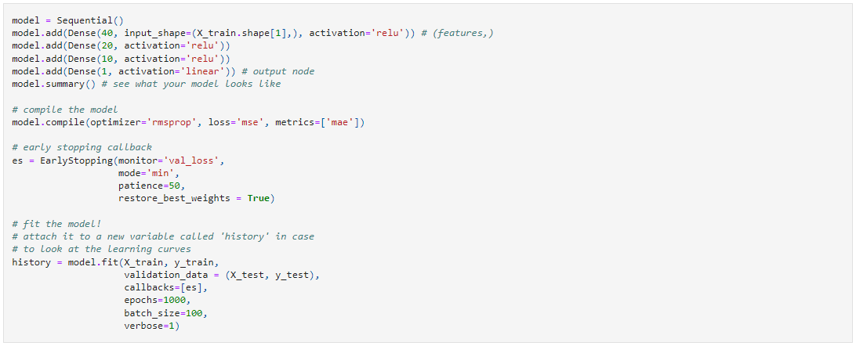
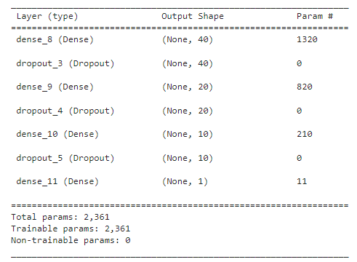
Making our own Deep Learning Model
Over our iterations it became apparent that a network with less neurons actually behaved better across our dataset. We also found that our model had significant loss but our training and testing datasets had similar results - we believe that with further adjustments we will be able to train a model that is as accurate as the pre trained library.

Slide 14
Conclusion
Pre-trained models from the SKlearn libraries were quite accurate with our dataset once it was properly cleaned and scaled.
Experience with our own tests - loss was significant early on but started trending down. Further modification to the NN to increase accuracy will ensure a model that performs as well as the pre-trained models.
We believe that with sufficient data for your chosen market you can accurately predict the value of a used vehicle by using a regression method.

